Slide 1
The First Day of School
Lauren Kovacs
Social Studies
Choices in Little Rock
SS-HS-1.2.2 Students will interpret the principles of limited government and evaluate how these principles protect individual rights and promote the common good.
SS-HS-5.1.1 Students will use a variety of tools (e.g., primary and secondary sources, data, artifacts) to analyze perceptions and perspectives (e.g., gender, race, region, ethnic group, nationality, age, economic status, religion, politics, geographic factors) of people and historical events in the modern world and United States History .
Learning Target: I can explain how the rights of an individual may at times be in conflict with the rights of others

Slide 2
The First Day of School
Recall your first day at Fern Creek High School.
What were your expectations?
What were you excited about? What did you fear?
How did you prepare for the day?
What surprised you the most about your first day?

Slide 3
This is where the students are going to share their ideas about the first day and make predictions about the first day for the Little Rock 9
P.S. sometimes they think I am lying when I ask them to do a journal or quick write. I’m serious, I want to hear their expectations, excitements and fears!
HELLO! What were those questions again?

Slide 4
Integration Plan
by
Little Rock Arkansas School Board
Developed 1955
Enacted 1957
Horace Mann
100% African American
Hall
100% White
[NEW!}
Integrate the old white school
CENTRAL HIGH SCHOOL

Slide 5
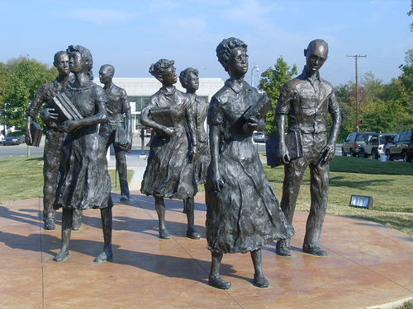
Application Process for Central High
What was the application process for students?
Grades
Sustain pressure of integration [minority in majority]
No sports
No extracurricular activities
Who qualified?
17 became 10 became 9
Were there any other qualifications?
http://www.google.com/imgres?q=little+rock+9&hl=en&client=firefox-a&hs=0Ae&sa=X&rls=org.mozilla:en-US:official&biw=1047&bih=510&tbm=isch&prmd=imvns&tbnid=n5Ni70GET-jyEM:&imgrefurl=http://www.thenayshun.com/2010/09/07/civil-rights-hero-jefferson-thomas-from-the-little-rock-nine-passes-away&docid=-r0f43hvpUE5cM&imgurl=http://www.thenayshun.com/wp-content/uploads/2010/09/lr9.jpg&w=500&h=375&ei=CpiLT9z4H4nugger9OzhCQ&zoom=1&iact=rc&dur=749&sig=116549848824089600323&page=3&tbnh=144&tbnw=208&start=23&ndsp=12&ved=1t:429,r:9,s:23,i:199&tx=90&ty=68

Slide 6
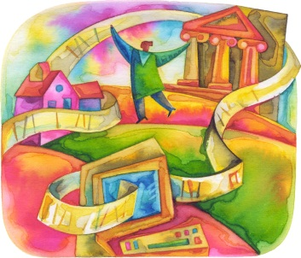
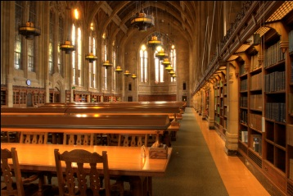
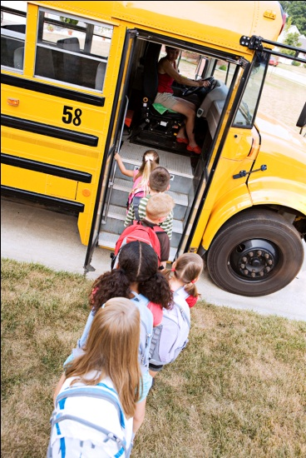
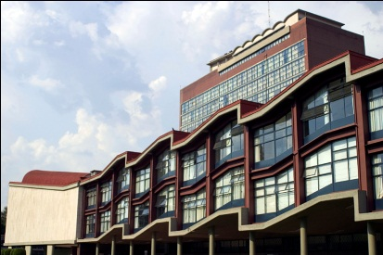
Trouble Expected?
NO!
Fort Smith, Arkansas Schools
Library
Buses
Medical school/law school- Blacks Allowed!
            Steve Fayer. Vintage, 1990, 39.

Slide 7
Expect the Unexpected
September 3, 1957
“He said troops would be out in from of the school and they would bar our entrance to Central- for our protection as well as for the protection and tranquility of the city”
    - Ernest Green speaking of Orval Faubus’s TV announcement

Slide 8
The SUPREME COURT SAID INTEGRATE
Daisy Bates [President NAACP- Arkansas]
Little Rock 9 instructing meet together to go to school
Elizabeth Eckford, 15 years-old, has no phone

Slide 9
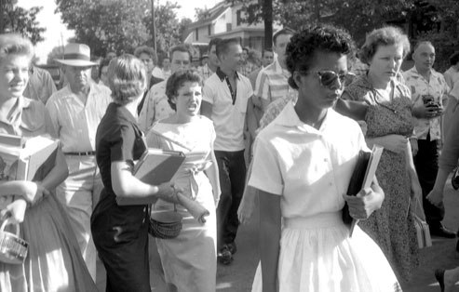
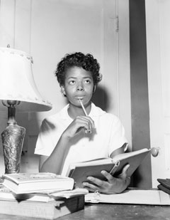
September 4, 1957
http://www.vanityfair.com/politics/features/2007/09/littlerock200709

Slide 10
What does your caption say?
Look at the photograph and come up with a caption…
Caption 2…

Slide 11
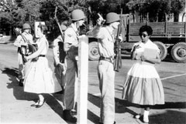
Arkansas National Guard
http://www.vanityfair.com/politics/features/2007/09/littlerock200709

Slide 12
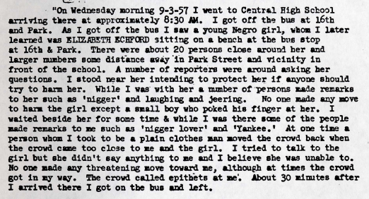

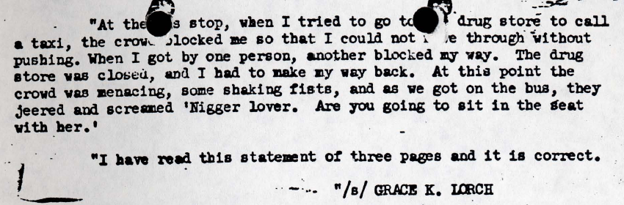
Footage
Help

Slide 13
Elizabeth 4 years later
http://www.criticalpast.com/video/65675024012_Nine-from-Little-Rock_Jefferson-Thomas_Elizabeth-Eckford_students-in-a-circle-sing

Slide 14
Integration of Central High School
Decision to Integrate
Little Rock School Board
Governor Faubus
Delay
Governor Faubus
Arkansas National Guard
Integration
Unsuccessful
Elizabeth’s entry
MOB!
Notes:
Let’s Review

Slide 15
Follow up
How can the rights of an individual may at times be in conflict with the rights of others?
Marcia Webb, a white student at Central
High and a bystander on September 4, 1957, later reflected on her choices that morning:
I remember the picture in the newspaper of Elizabeth Eckford with the jeering
white faces behind her. And at that moment I thought, Marcie, you were there
and you never once thought about what was going on with Elizabeth Eckford. You
were glad there weren’t any violent demonstrations; you were glad no one was hurt
physically. But then I realized what hurt can come from words, from silence even,
from just being ignored. And when I think about it now, I think about it with
regret. I’m sorry to say now looking back that what was happening didn’t have more
significance and I didn’t take more of an active role. But I was interested in the
things that most kids are.
What is the end result of names and labels, the silence of neighbors or classmates, or “just being ignored”?
How might the situation at Central High School have been different if Marcia Webb and other white students had regarded Eckford and other African American students as “kids” much like themselves?

Slide 16
Follow up
What is a mob? How is it different from a gathering or a crowd?
Perlesta Hollingsworth is an African American who lived near Central High in 1957.
In 1997, he told a reporter, “The shocking thing to me in 1957 was
the number of whites who didn’t participate in the aggression, who wouldn’t do anything but look. Neighbors would express dismay, but wouldn’t do anything, wouldn’t speak out against it, would go ahead and close their doors to it.”
Predict what will happen to Elizabeth and the rest of the Little Rock Nine.

